Slide 1
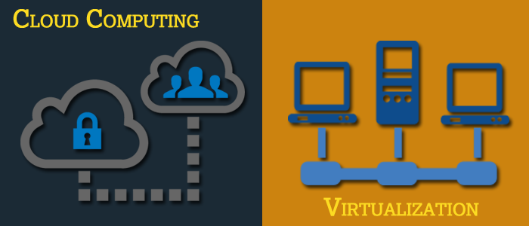
Basics of Virtualization and Cloud Technology

Slide 2
Chapter 3: Introduction to VDI and VM in Virtualization

Slide 3
Introduction to VDI and VM in Virtualization
Why VDI?
What is VDI?
Benefits of VDI
Introduction to VM
Various Components of VM

Slide 4
Traditional Desktop Deployment
Tight binding between layers
The components are linked together in ways that are difficult to support and maintain
A problem at one layer often causes a chain reaction
May destroy the whole stack
Makes recovery difficult
Threatens any locally stored user data and settings
Most organisations just replace or re-image the whole PC
User data and preferences
Desktop Management
X
Tightly
Coupled
1. procure
8. retire
X
X
Profile
Apps
2. image
7. back-up
Applications
Windows
3. secure
6. maintain
Hardware
Locally Installed
4. deploy
5. monitor
Existing methods, tools and processes
Operating System

Slide 5
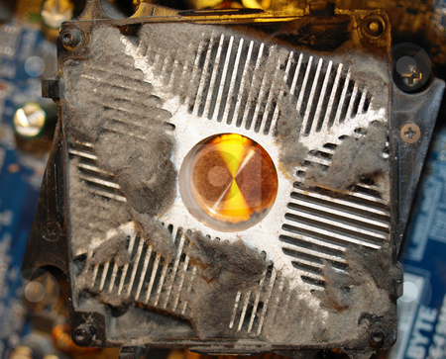

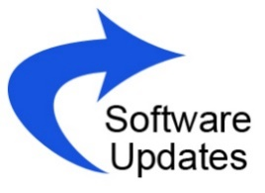
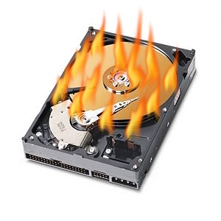
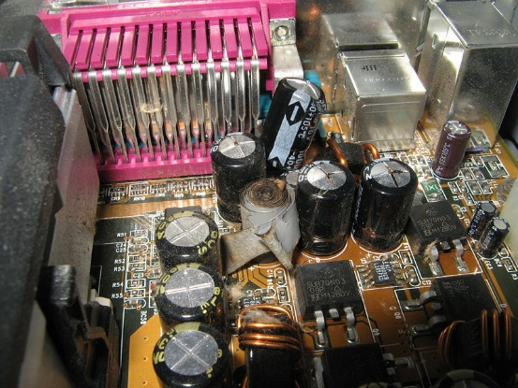
Why VDI?

Slide 6
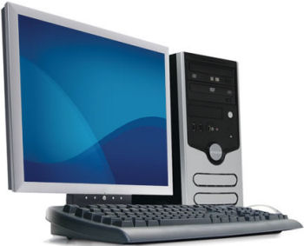
Why VDI?
Traditional desktop infrastructure challenges have led to use of virtual desktop infrastructure
Difficult to manage
Variety of PC hardware and users’ need
Broadly distributed PC hardware
Inefficient resource utilization
The distributed nature of PCs
High total cost of ownership
High cost of PC management and support
Lack of standardisation and the need for support personnel to troubleshoot issues
Difficult to protect and secure data
Data back-up and data restored when PCs are failed or files are lost
The risk of PC theft threatens the security of important data

Slide 7
End users and IT expectations from personal computers
End Users | IT Expectations
Increased Mobility Anywhere access Device independence Roam across PCs | Security and Compliance Stolen laptops and data loss Stringent regulation Protection of IT environment
Utilisation More workspace freedom Flexible configurations Access through own devices | Cost Reduction Increased computing complexity Escalating operational costs Disaster recovery

Slide 8
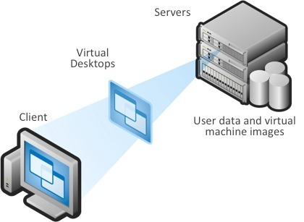
What is VDI?
Virtual Desktop Infrastructure (VDI) is a computing model that adds a layer of virtualization between the server and the desktop PCs.
Virtual desktop infrastructure (VDI) is a virtualization technology that hosts a desktop operating system on a centralised server in a data centre. VDI is a variation on the client-server computing model, sometimes referred to as server-based computing. The term was coined by VMware.
Source: http://searchvirtualdesktop.techtarget.com/definition/virtual-desktop-infrastructure-VDI

Slide 9
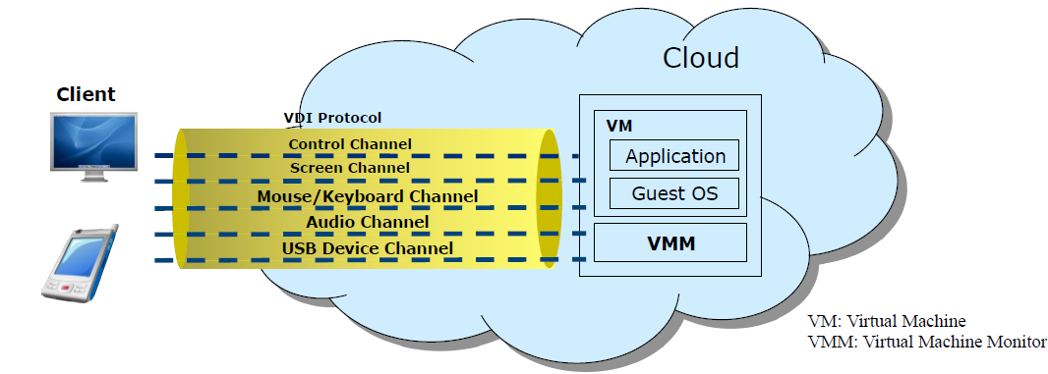
VDI is a desktop-centric service
Host users desktop environments on remote servers and/or blades, which are accessed over a network using a remote display protocol (RDP).

Slide 10
Generic View of VDI
VDI Client: The converged end user device
VDI Server: Delivers a desktop from a server operating
system for a single user
Virtual Desktop Agent: The control software resides in a virtual machine hosted in a data center
VDI Protocol: Connect client and server, transport the necessary control commands and I/O data
VDI Client
VDI Server
VDI Protocol
Virtual Machine hosted in a Data Center
Guest OS
Virtual Desktop Agent

Slide 11
VDI Components
Session
Broker
Virtualization
Platform
Client
Devices
Virtual Machine
Virtualization
Management
Platform
Guest OS
Protocol

Slide 12
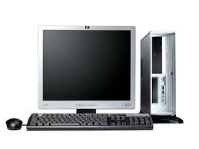
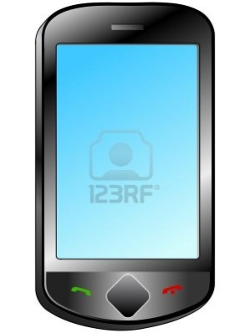
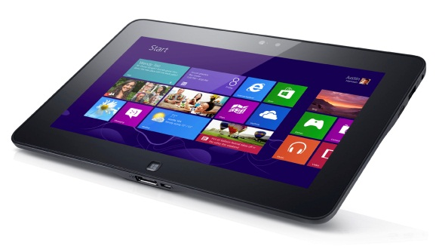
Client Devices
Client devices are access points.
It could be
Thin Client: A thin client is a lightweight computer built to connect to a server from a remote location. The server does most of the work, which can include crunching numbers and storing information for the thin client.
Clients running software on OS
Such as, Windows, Linux or others supported by the VDI solution

Slide 13
Session Broker
Session
Broker
Client
VM
Client
. . .
VM
. . .
Client
VM
The session broker is responsible for:
Distributing sessions from clients to VMs
Redirecting disconnected sessions of users back to their original VMs
Example: Windows Server 2008 R2, XenDesktop (for Microsoft VDI) and VMware View Manager

Slide 14
Virtualization Platform
A platform hosts VMs with the client operating systems
This platform must have the capacity to host enough VMs for all concurrently connected users
Virtual Machine
Guest OS
Virtual Machine
Guest OS
Virtual Machine
Guest OS
Virtualization Platform

Slide 15
Virtualization Management Platform
Virtual management platform is a platform that
Manages the servers
Provisions VMs quickly and efficiently
Uses templates and libraries of disk images to provision the client OS in VMs
It ensures there is always a pool of VMs available for new connections.

Slide 16
Benefits of VDI
As more organisations are moving to the cloud environment. Following are some of the benefits of the VDI:
Usage of Less Bandwidth
Reduce IT Costs up to 30 Percent
Access Workstations Anywhere
Data is More Secure
Assign Information Access according to an Employee’s Security Clearance
Use VDI to Access Very Large Files
Backup Data Just Once
Save Power
Source: http://www.mavenspire.com/blog/top-10-benefits-of-vdi/
Notes:
Usage of Less Bandwidth: One of the benefits of VDI is that it puts all information that ordinarily would be on a user’s computer on a server in a data centre. You can save both time and money by making the same data available to all users on the network.
Reduce IT Costs up to 30 Percent: You can install updates and patches once rather than many times. You also have only one system to troubleshoot rather than several. This helps your organisation by allowing your IT staff to focus on significant issues instead of engaging in redundant work for every computer in the network.
Access Workstations Anywhere: One of the most significant benefits of VDI is users can access their workstations from all types of devices, from smartphones and iPads, to laptops and desktops out of office. In addition, on all devices, the user interface and layout will be the same. This increases agility and reduces the employee learning curve.
Data is More Secure: Data is better protected when stored on the server rather than on individual devices. This helps a company protect its data and reduce chances of file corruption by viruses.
Assign Information Access according to an Employee’s Security Clearance: You can provide users different levels of access depending on their security clearance. This provides agencies with the ability to establish barriers for content and activities.
Use VDI to Access Very Large Files: One of the main benefits of VDI is that all users on a network can access large files, such as, CAD documents and video files. Individual devices would expend unnecessary amount of time and energy accomplishing this on a local area network.
Backup Data Just Once: If you have the right procedures in place, you can backup data without the risk of losing any files. This reduces costs and allows backups to be conducted regularly.
Save Power: If you have the right procedures in place, you can backup data without the risk of losing any files. This reduces costs and allows backups to be conducted regularly.

Slide 17
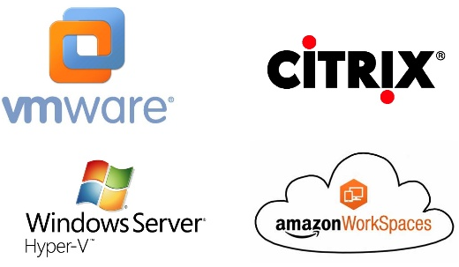
Players of VDI

Slide 18
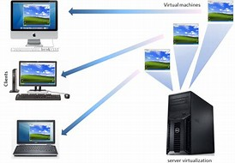
Why virtual machine is used?
Installing a new operating system by simply removing an existing OS and taking backup of file and folder and installing the same software on a new OS is a tedious job.
There is always a risk that the new operating system may not work or does not meet the expectation or need, mostly in the case of different Linux distribution. However, there is still an option to install OS on a system and boot the system using dual boot option, but it usually changes the boot loader file and in some cases primary OS is not shown while booting. Therefore, the safest and easiest way to install and test OS on a system is through virtualization using a virtual system.
Using a virtual system, we can try a different operating system without leaving the primary OS. We can also test different software on different OS environment. Besides personal usage of virtual system, virtualization is one of the growing areas for companies and organisations investing in server virtualization for their purposes.
Source : http://www.techieinspire.com/virtual-machine/
Notes:
The main benefit for business users is server consolidation, which supports different servers running on virtual machine from the single server instead of running multiple’s servers. This significantly helps in reducing the physical space and one does not need to worry about security and maintenance of multiple servers. It also helps companies save costs of purchase of new hardware and costs of maintenances for different servers. Moreover, it is possible to perform server migration without much of hassle using virtualization.

Slide 19
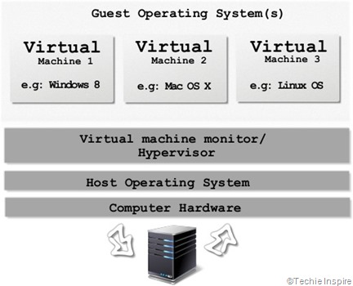
What is virtual machine?
A virtual machine is a software that creates a virtual environment of physical computing and emulates just as a real machine that allows a user to install operating system or programs to run virtually. This process is also referred as virtualization. Virtual machine runs on your current operating system which is called as “host” operating system and operating system installed on Virtual Machine referred as “guest” operating system. The guest operating system will run on your host operating system just like any other program on your computer.
Notes:
With the help of virtualization, it creates virtual hardware resources, such as, CPU, memory, hard disk, CD-ROM, Network and others using the underlying physical hardware of the system. Sharing and managing host hardware resources under the virtualization layers is also called as hypervisor or virtual machine monitor (VMM). A hypervisor is a program that is responsible for allowing each guest operating system with a set of virtual hardware resources shared from the host hardware resources and control the flow of information between guest and host software and hardware resources.

Slide 20
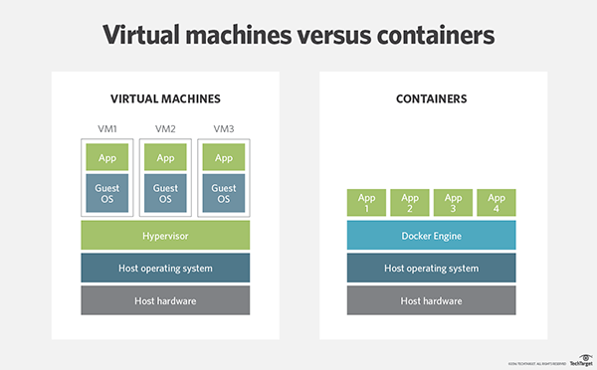
Key Benefits of Virtual Machines
Partitioning: Run multiple operating systems on one physical machine and divide system resources between virtual machines.
Isolation: Provide fault and security isolation at the hardware level and preserve performance with advanced resource controls.
Encapsulation: Save the entire state of a virtual machine to files. Move and copy virtual machines as easily as moving and copying files.
Hardware Independence: Provision or migrate any virtual machine to any physical server.
Source: https://www.vmware.com/in/solutions/virtualization.html

Slide 21
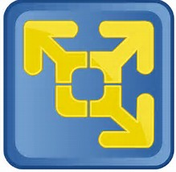
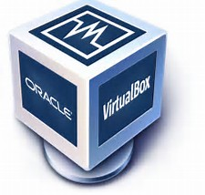
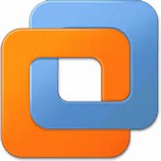
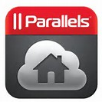
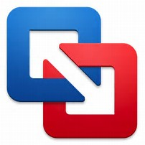
List of Popular Virtual Machine Software that Runs on a Desktop OS
VMware Player
Oracle VM VirtualBox
VMware Workstation
Parallels
VMware Fusion
Notes:
VMware Player is a FREEWARE for personal use software that will allow to mount and run VMs directly from a Windows or Linux desktop. Though it cannot create new VMs from an ISO, it is still a powerful virtual machine software. There is also VMware Player Plus version with enhanced features, but it will require purchasing a license.
Oracle VM VirtualBox is another FREE virtual machine software and alternative to VMware Workstation which is an excellent choice for beginners. Great for lab testing and running from the desktop, VirtualBox installs on Windows, OS X, Solaris and Linux. Unlike VM Player, this FREEWARE allows the creation of new virtual machines from ISO or importing. And will run most 32 and 64bit operating systems as a VM.
VMware Workstation is a full-featured virtual machine software that requires licensing. This software is for advanced users who require running multiple systems. For example, it works well for developers needing database, web and application servers all in the same virtual space. It also allows saving projects and cloning.
Parallels is a full-featured virtual machine software which began especially to run a Windows virtual machine on Apple OS X.
VMware Fusion requires purchasing a license too and is another way to run Windows on a Mac.

Slide 22
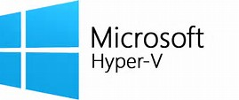
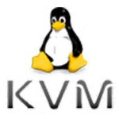
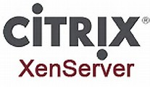
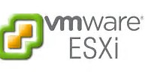
List of Popular Virtual Machine Software that Runs on a Server Hardware
Microsoft Hyper-V,
XenServer
KVM (Kernel-based Virtual Machine)
VMware ESXi (formerly ESX)
Notes:
Microsoft Hyper-V, formerly known as Windows Server Virtualization, is a native hypervisor; it can create virtual machines on x86-64 systems running Windows. Starting with Windows 8, Hyper-V superseded Windows Virtual PC as the hardware virtualization component of the client editions of Windows NT. A server computer running Hyper-V can be configured to expose individual virtual machines to one or more networks.
XenServer is an industry-leading, open source platform for cost-effective application, desktop, cloud and server virtual infrastructures. XenServer enables organisations of any size or type to consolidate and transform compute resources into virtual workloads for today’s data centre requirements, while ensuring a seamless pathway for moving workloads to the cloud.
KVM (Kernel-based Virtual Machine) is a full virtualization solution for Linux on x86 hardware containing virtualization extensions (Intel VT or AMD-V). It consists of a loadable kernel module, kvm.ko that provides the core virtualization infrastructure and a processor specific module, kvm-intel.ko or kvm-amd.ko. Using KVM, one can run multiple virtual machines running unmodified Linux or Windows images. Each virtual machine has private virtualized hardware — a network card, disk, graphics adapter and others.
VMware ESXi (formerly ESX) is an enterprise-class, type-1 hypervisor developed by VMware for deploying and serving virtual computers. As a type-1 hypervisor, ESXi is not a software application that is installed on an operating system (OS); instead, it includes and integrates vital OS components, such as a kernel.

Slide 23
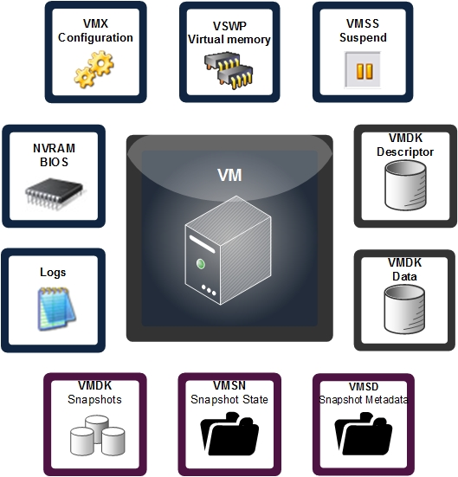
Components of Virtual Machines-Files
Configuration File
Hard Disk File (s)
Virtual Machine State File
In-memory File
Source: https://kb.vmware.com/s/article/144
Notes:
Configuration File: When a new virtual machine is created with the New Virtual Machine Wizard, the information collected by the wizard is saved to a file called .vmx on a Windows host or .cfg on a Linux host. The configuration file for that virtual machine is stored in the folder or directory specified in the wizard.
Hard Disk File (s): This is a virtual disk file, which stores the contents of the virtual machine's hard disk drive. A virtual disk is made up of one or more .vmdk files. If a user has specified that the virtual disk should be split into 2GB chunks, the number of .vmdk files depends on the size of the virtual disk. As data is added to a virtual disk, the .vmdk files grow in size, to a maximum of 2GB each.
Virtual Machine State File: This is the snapshot state file, which stores the running state of a virtual machine at the time you take that snapshot and is identified with a file name snapshot.vmsn
In-memory File: The .nvram file. This small file contains the BIOS that is used when the VM boots. It is similar to a physical server which has a BIOS chip that lets you set hardware configuration options.

Slide 24
VMware Workstation
VMware Workstation is a hosted hypervisor that runs on x64 versions of Windows and Linux operating systems (an x86version of earlier releases was available); it enables users to set up virtual machines (VMs) on a single physical machine and use them simultaneously along with the actual machine. Each virtual machine can execute its own operating system, including versions of Microsoft Windows, Linux, BSD and MS-DOS. VMware Workstation is developed and sold by VMware, Inc., a division of Dell Technologies.
Browse the following link to install VMware Workstation on Windows OS to run your first virtual machine:
https://kb.vmware.com/s/article/1018415

Slide 25
Creating Virtual Machine using Microsoft’s Hyper-V
Microsoft could not ignore the virtualization trend. Microsoft introduced Hyper-V as a virtualization platform in 2008 and it continued to release new Hyper-V versions with new Windows server versions. So far, there are a total of four versions, including Windows Server 2012 R2, Windows Server 2012, Windows Server 2008 R2 and Windows Server 2008.
Browse the following link to create virtual machine using Hyper-V:
https://hyperv.veeam.com/blog/what-is-hyper-v-technology/

Slide 26
Creating Virtual Machine using Oracle’s VirtualBox
Oracle VM VirtualBox is a free and open-source hypervisor for x86 computers currently being developed by Oracle Corporation.
A VirtualBox is a software virtualization package that installs on an operating system as an application. VirtualBox allows additional operating systems to be installed on it, as a Guest OS and run in a virtual environment.
Browse the following link to create virtual machine using VirtualBox
https://www.wikihow.com/Install-VirtualBox

Slide 27
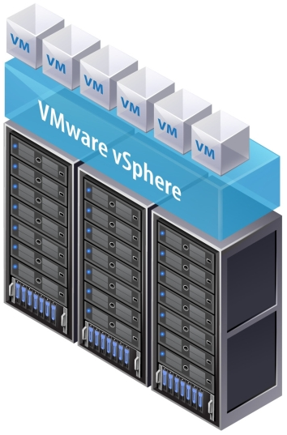
Components of VMware vSphere Virtual Machine
A virtual machine is a software representation of a physical computer and its components.
The virtualization software converts the physical machine and its components into files.
Virtual machines typically have an operating system, VMware Tools, and virtual resources and hardware that can be managed in much the same way as it is managed in physical computer.
A user installs a guest operating system on a virtual machine the same way as installing an operating system on a physical computer. A user must have a CD/DVD-ROM or ISO image containing the installation files from an operating system vendor.
VMware Tools is a suite of utilities that enhances the performance of the virtual machine's guest operating system and improves management of the virtual machine. With VMware Tools, you have more control over the virtual machine interface.
In the vSphere Web Client, user assigns each virtual machine to a compatible ESXi host version, cluster, or datacentre by applying a compatibility setting. The compatibility setting determines which ESXi host versions the virtual machine can run on and the hardware features available to the virtual machine.
Source: https://kb.vmware.com/s/article/1010675

Slide 28


